Slide 1

7
Chapter
Managing
Communication and Information
© Pearson Education Limited 2015
13-<number>

Slide 2
Learning Outcomes
Describe what managers need to know about communicating effectively.
Explain how technology affects managerial communication.
Discuss contemporary issues in communication.
© Pearson Education Limited 2015
13-<number>

Slide 3
7.1
Define what managers need to know about communicating effectively.
© Pearson Education Limited 2015
13-<number>

Slide 4
Effective Communication
Communication:
A process or flow that transfer of understanding and meaning from one person to another.
A purpose, expressed as a message to be is needed
© Pearson Education Limited 2015
13-<number>

Slide 5
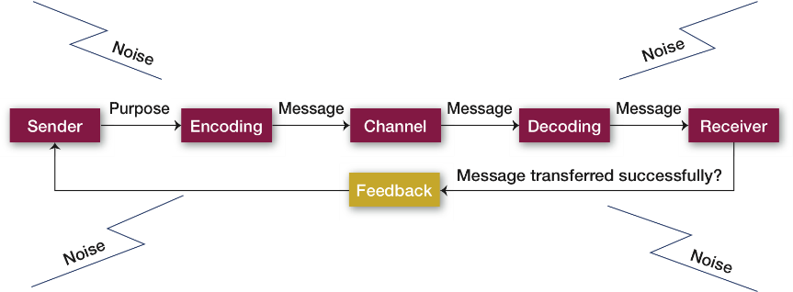
The Communication Process
© Pearson Education Limited 2015
13-<number>

Slide 6
Factors Affecting Encoding
  T he source initiates a message by encoding a thought.
  Skill; a person’s total communicative success and includes speaking, reading, listening, and reasoning skills.
  Attitudes; influence our behavior.
  Knowledge;
  Social cultural system; our beliefs and values—influences each of us as a communicative source
© Pearson Education Limited 2015
13-<number>

Slide 7
Communication Channels
Formal channels
Informal channels
© Pearson Education Limited 2015
13-<number>

Slide 8
Formal channels; are established by the organization, transmit job-related messages, and traditionally follow the authority network within the organization
Ex: meeting at company headquarters
© Pearson Education Limited 2015
1-<number>

Slide 9
Personal or social messages follow the informal channels in the organization.
© Pearson Education Limited 2015
1-<number>

Slide 10
Decoding and Feedback
Skills, attitudes, knowledge, and social culture of the receiver to whom the message is directed affect his or her ability to decode the message.
© Pearson Education Limited 2015
1-<number>

Slide 11
Decoding and Feedback
Decoding:
Translating a received message.
Feedback:
Checking to see how successfully a message has been transferred.
Ex: Effective feedback is critical due to the cultural diversity of today’s workforce
© Pearson Education Limited 2015
13-<number>

Slide 12
Written v.s. Verbal Communication
Written communications include
Memos
Letters
Email
other forms of digital communication
organizational periodicals
bulletin boards
or any other device that transmits written words or symbols.
1-<number>

Slide 13
Written vs. Verbal Communication
Advantages
Tangible/verifiable
Permanent record
Stored for later reference
Well-thought out
Drawbacks:
Time consuming
Doesn’t lend itself to feedback like oral communication
© Pearson Education Limited 2015
13-<number>

Slide 14

The Grapevine
© Pearson Education Limited 2015
13-<number>

Slide 15
The Grapevine
The grapevine is the unofficial way that communications take place in an organization and it’s neither authorized nor supported by the organization.
© Pearson Education Limited 2015
1-<number>

Slide 16
The Grapevine
In the grapevine, information is spread by word of mouth—and even through electronic means.
Good information travels quickly, but bad information travels even more quickly.
© Pearson Education Limited 2015
1-<number>

Slide 17
Nonverbal Cues
Some of the most meaningful communications are neither spoken nor written.
© Pearson Education Limited 2015
1-<number>

Slide 18
Nonverbal Cues
These nonverbal communications
  a loud siren
  red flashing light
  the size of a person’s office and desk
  someone’s clothing—convey messages to others.
  The best-known areas of nonverbal communication are body language and verbal intonation.
© Pearson Education Limited 2015
1-<number>

Slide 19
Nonverbal Cues
Research indicates that from 65 to 90 percent of the message of every face-to-face conversation is communicated through body language.
© Pearson Education Limited 2015
1-<number>

Slide 20
Nonverbal Cues
Body language refers to
  gestures
  other movements of the body
  hand motions
  facial expressions
  other gestures can communicate emotions such as aggression, fear, shyness, arrogance, joy, and anger
© Pearson Education Limited 2015
1-<number>

Slide 21
Nonverbal Cues
Verbal intonation refers to the emphasis someone gives to words or phrases, and can make a statement sound defensive or friendly.
“it’s not what you say but how you say it”
© Pearson Education Limited 2015
1-<number>

Slide 22
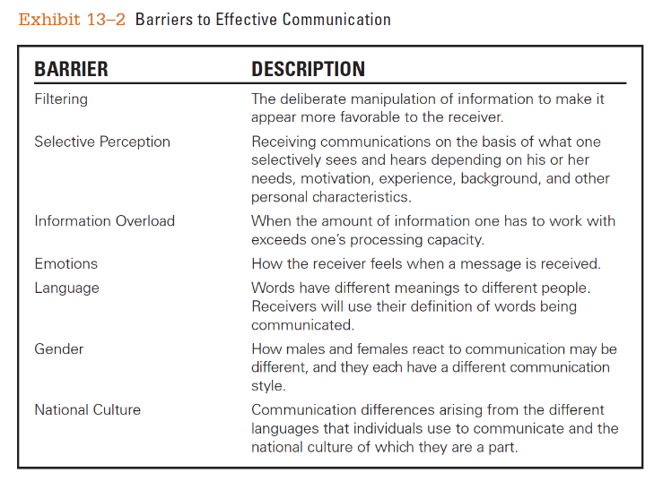
Communication Barriers
© Pearson Education Limited 2015
13-<number>

Slide 23
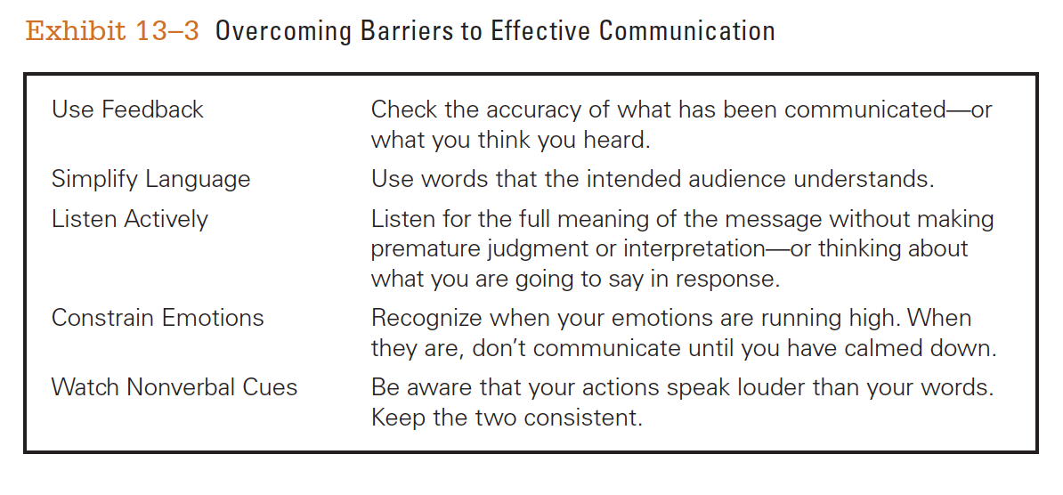
Overcoming Communication Barriers
© Pearson Education Limited 2015
13-<number>

Slide 24
7.2
Explain how technology affects managerial communication.
© Pearson Education Limited 2015
13-<number>

Slide 25
Technology and Communication
Information technology has radically changed the way organizational members communicate. IT,
  Improves managers ability to monitor individual and team performance,
  Allows employees to have more complete information to make faster decisions,
  Provides employees more opportunities to collaborate and share information,
  Allows employees to be fully accessible 24/7.
1-<number>

Slide 26
Technology and Communication
Networked computer systems
Wireless capabilities
© Pearson Education Limited 2015
13-<number>

Slide 27
Networked Communication
In a networked computer system, organizational computers are linked through hardware and software, creating an integrated organizational network.
Employees communicate with each other and get information wherever they are.
© Pearson Education Limited 2015
1-<number>

Slide 28

Networked Communication Applications
E-mail; transmission of messages on linked computers. It’s fast, cheap, efficient and convenient.
Instant messaging (IM)
Voice-mail
© Pearson Education Limited 2015
13-<number>

Slide 29
Networked Communication Applications (cont.)
Teleconference and videoconference meetings
Internet-based voice/video communication; Skype, Viber , FaceTime, Vonage, and Yahoo!
Organizational intranet
Organizational extranet
© Pearson Education Limited 2015
13-<number>

Slide 30
Wireless Communication
People don’t need to be physically at the office to communicate, collaborate, and share information with managers and colleagues.
“keep in touch” using smartphones, tablet computers, notebook computers
People can send and receive information from anywhere
13-<number>

Slide 31
7.3
Discuss contemporary issues in communication.
© Pearson Education Limited 2015
13-<number>

Slide 32
Contemporary Issues
  Communication management in an Internet world
  Managing the organization’s knowledge resources
  Communicating with customers
  Getting employee input
  Communicating ethically
© Pearson Education Limited 2015
13-<number>

Slide 33
Communication in an Internet World
  Legal and security issues
  Lack of personal interaction
© Pearson Education Limited 2015
13-<number>

Slide 34
Legal and Security Issues
Electronic information is potentially admissible in court
Sensitive, proprietary information at risk
© Pearson Education Limited 2015
13-<number>

Slide 35
Personal Interaction
Social media can minimize personal interaction.
© Pearson Education Limited 2015
13-<number>

Slide 36
Knowledge Management
Cultivating a learning culture in which organizational members systematically gather knowledge and share it with others.
© Pearson Education Limited 2015
13-<number>

Slide 37
Customer Service
Three components in any service delivery process:
Customer
Service organization
Individual service provider
© Pearson Education Limited 2015
13-<number>

Slide 38
Strong Service Culture
Finding out what customer needs are, meeting these needs, and following up to make sure those needs were met satisfactorily.
© Pearson Education Limited 2015
13-<number>

Slide 39
Ethical Communication
Presented material that contains all the relevant information, is true in every sense, and is not deceptive in any way.
© Pearson Education Limited 2015
13-<number>

